Slide 1
GPT3.5 & Data Science
Week 2:
Progress
Lewen and Srikar
Notes:
Okay, but what even is data science in the first place??

Slide 2
Week Overview
Learn LLMs(Large Language Models)
Implement GPT-2 and GPT-3.5
Learn the basics of Gradio to make UIs
Explore Gradio’s key features
Gradio Block

Slide 3
The Code

Slide 4
Benefits vs Harms
Benefits
Harms
Generate and summarize text
Generate images
Wide variety of choices
Easy to use options
Messy layout
Inconvenient design (action)
Inefficient code
Certain limitations
Crazy outputs (extra hot and fiery hot)

Slide 5
Data Analysis Week 2

Slide 6
Our Plan (so far)
Learning SQL - w3schools
Acquiring a quality and standard dataset - Kaggle
Cleaning dataset - csv and python
Accessing cloud database - REPLIT
Analyzing dataset
Visualizing information clearly - R
Applying data
Notes:
Kaggle - open source platform
RDBMS - relational database management system
Use R cuz Rama said so
“Why R” “it’s beautiful” “but why R” “Because im comfortable in it”
Transition: So let’s take a look at the first step: Learning SQL

Slide 7
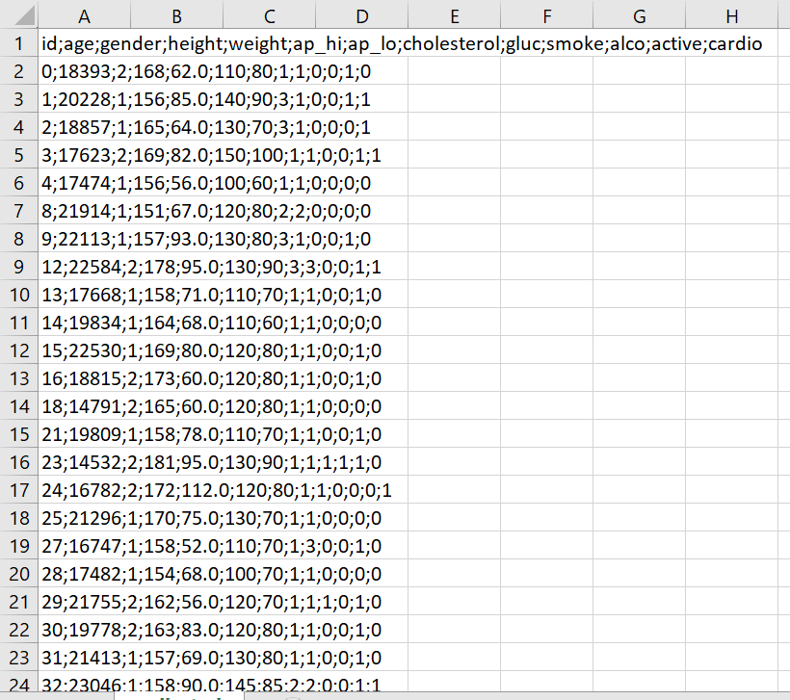
Cleaning the data
What is cleaning?
Deleting garbage values
Delimiters
Parsing

Slide 8
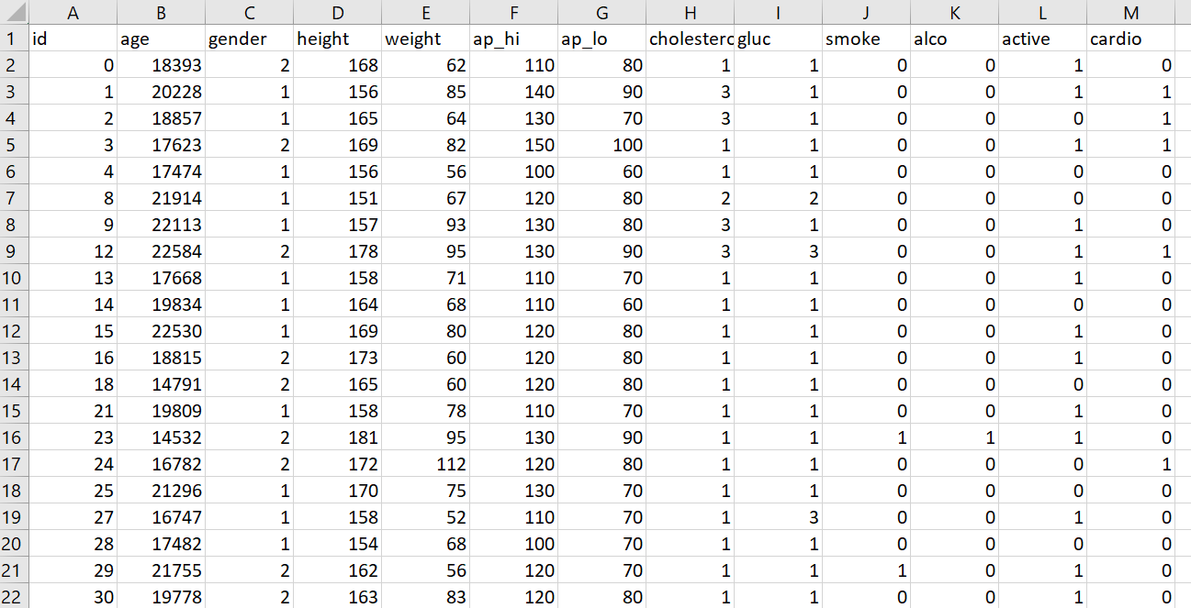
How the Data Set Works
Columns and Tuples
Primary Key
Understanding of Information
Queries

Slide 9
Looking forward to working with(for) Rama

